Slide 1
Using a Kalman filter to estimate position from noisy sensor data
Caitlin Parsons
2nd Year Computer Engineering

Slide 2
Problem Statement
Imagine a sensor which gives data on the position of an object such as a car.
The data can sometimes be noisy and unreliable.
A Kalman filter can be used to produce the most reliable estimate for the position and velocity of the object.
Kalman Filter
more accurate estimates
Sensor data

Slide 3
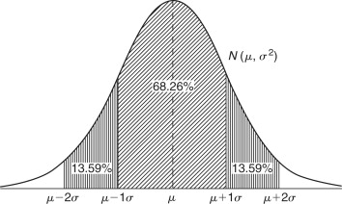
Assumptions we will use
Measurement model
Errors are zero-mean and Gaussian
Motion model
Object moves in one direction with constant velocity.
State vector
The filter infers velocity from successive position measurements.
The distribution of errors in the data

Slide 4
System Overview
Main.py
Plots results on graph using matplotlib
calls kalman_filter()
calls simulate_motion
Kalman.py
Simulation.py
kalman_filter()
Returns the array x_est, with estimated positions
Class simulationconfig
Defines parameters that are used to generate noisy data
t , x_true, z_meas
Returns x_est
simulate_motion(cfg)
Returns 3 arrays
t – time points
x_true – true motion
Z_meas – sensor measurements

Slide 5
How the Kalman filter works
Predicts the next state using constant velocity
Compares that prediction with the sensor measurement
Corrects the estimate based on uncertainty in the model (constant velocity) and uncertainty in the sensor data.
Previous estimate
Prediction
Sensor Measurement
Updated estimate

Slide 6
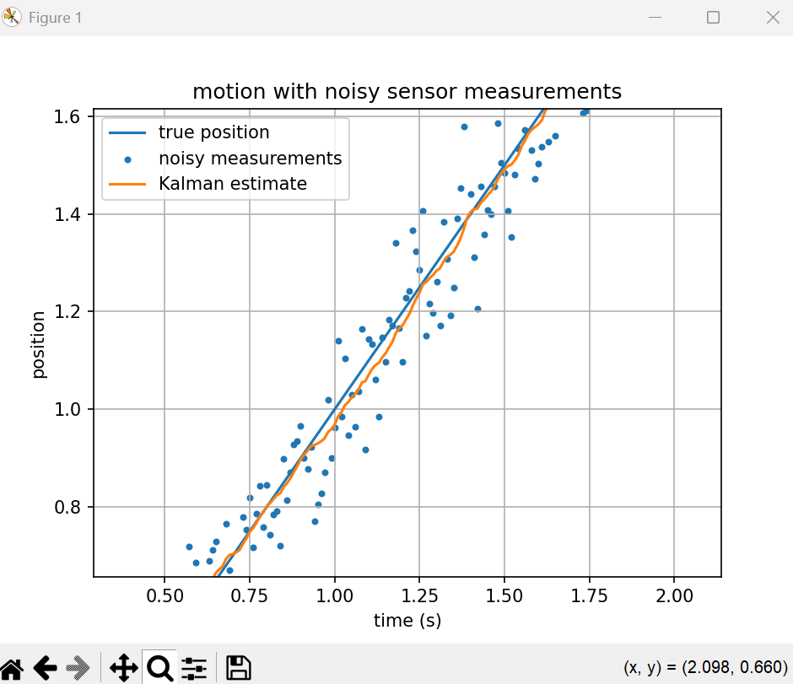
Example output
In this example, I have q , the parameter for uncertainty in the model, set to 0.01

Slide 7
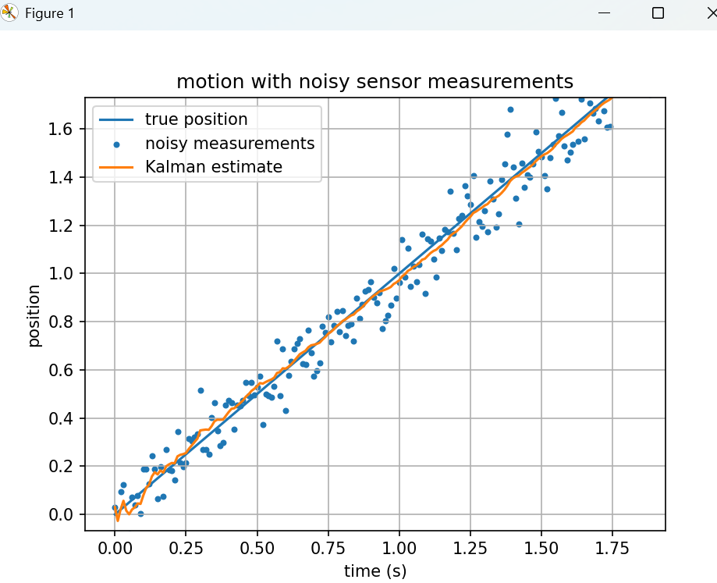
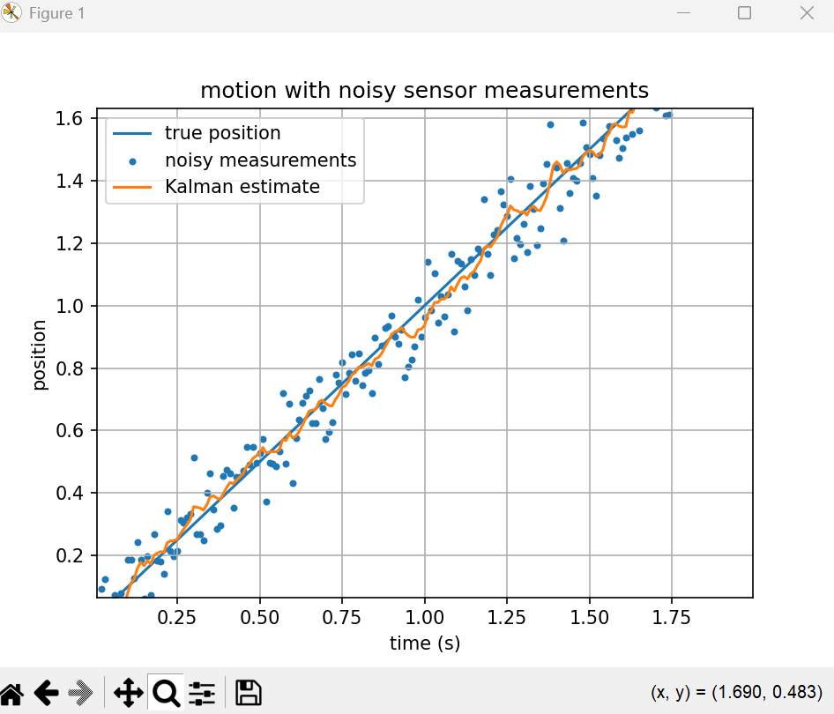
What happens when I adjust parameters
Q set to 0.001
Q set to 0.9

Slide 8
Key takeaways
Kalman filtering provides reliable estimates from noisy sensor data
Model assumptions and parameters can be adjusted to affect behaviour
This project provided me with experience in estimation and system modelling

